Slide 1

Finding Legendary Pokemons by Machine Learning
Applied Machine Learning Project:
By Chensheng Ma; Jianghui Li

Slide 2

What you gonna see?
Dataset Information
General Statistics Analysis
Supervised learning
Unsupervised Learning
Q & A

Slide 3

Introduction:
Our Dataset: There are 1032 rows and 44 columns.
Why Pokemon Dataset?
Task: Finding Legendaries

Slide 4



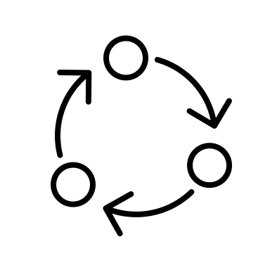


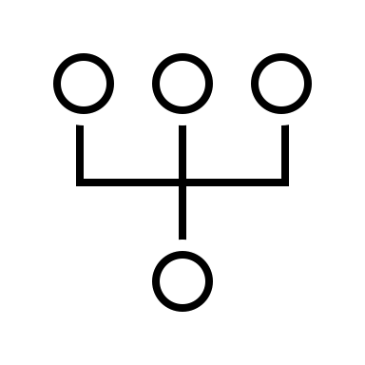
More about the Dataset:
Legendary
Type
Pokemon Catch Rate
Stats of Pokemon
Generation
Different evolution Form

Slide 5
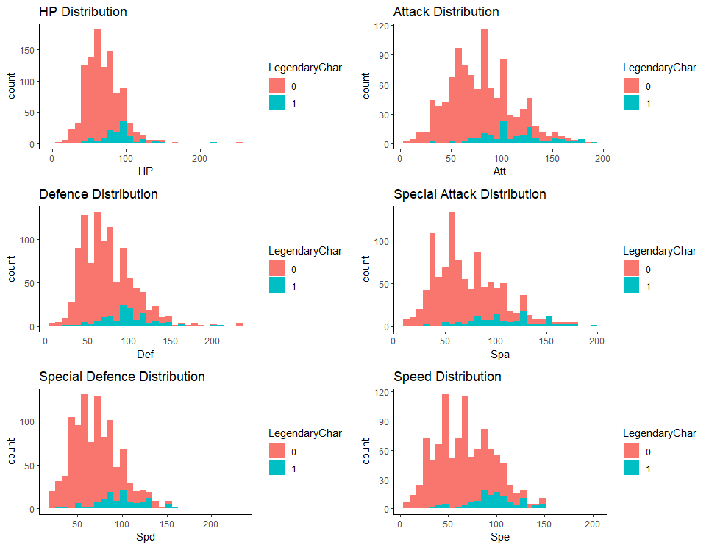
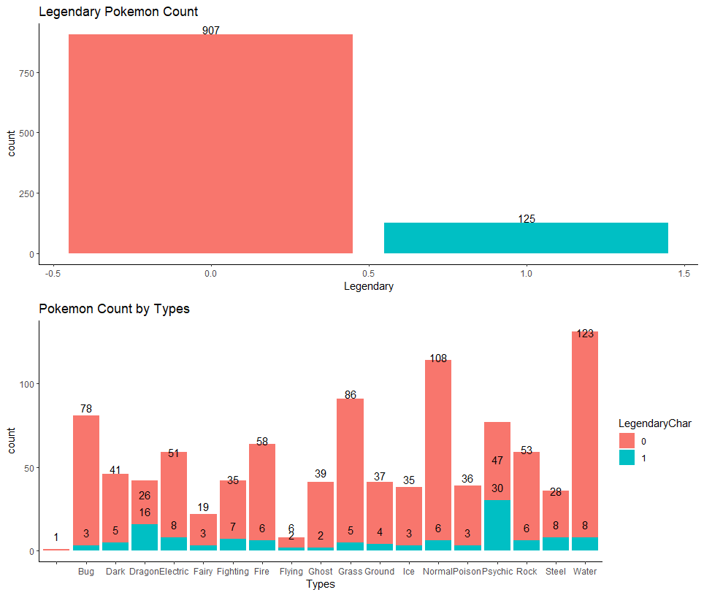
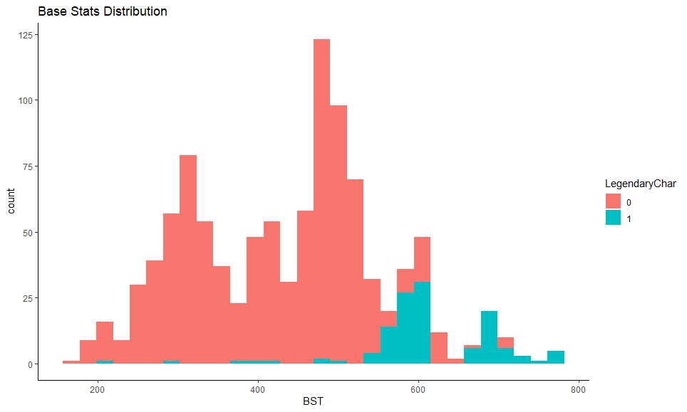
General statistical analysis of variables

Slide 6
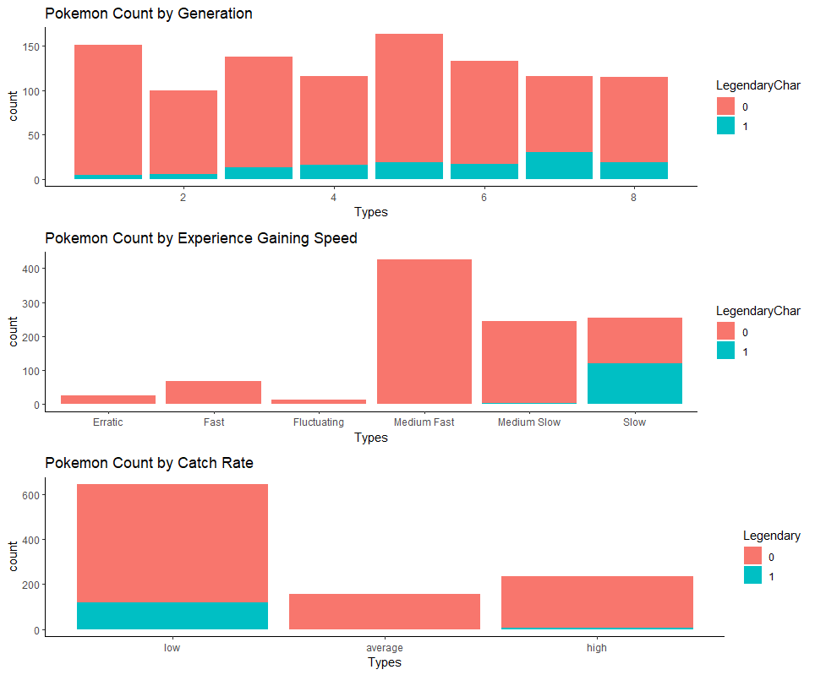
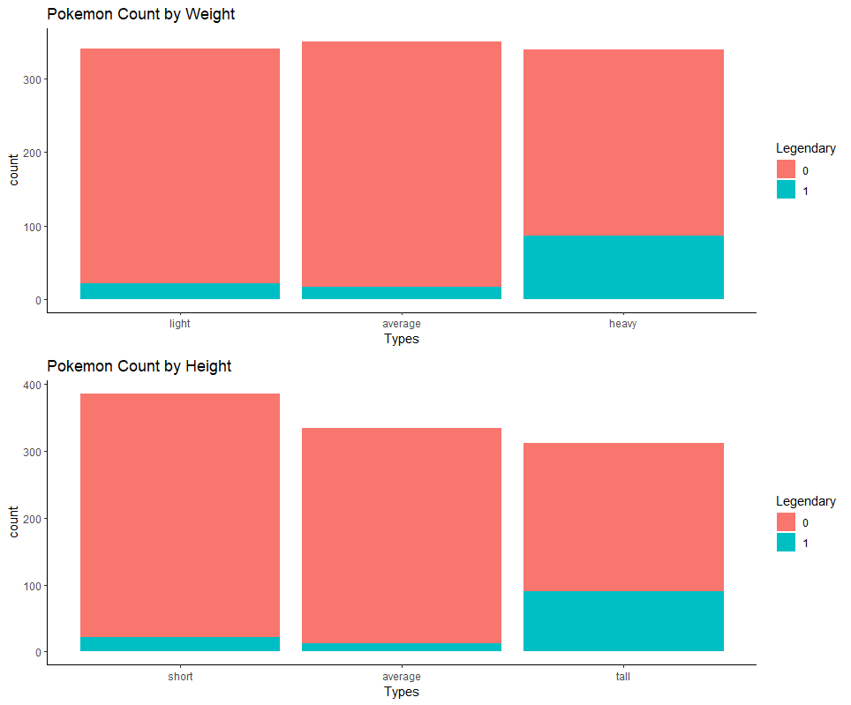

Slide 7
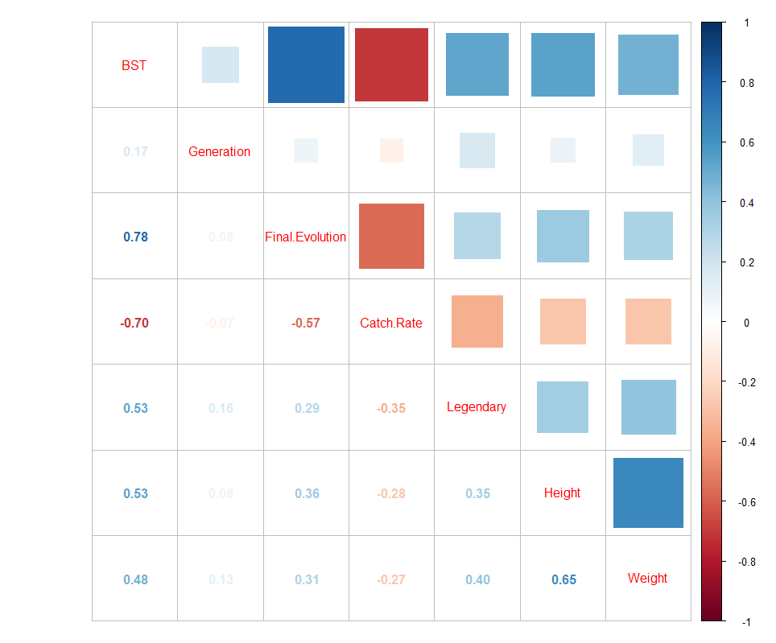
Correlation:

Slide 8

Supervised Learning:
Decision Tree
Support Vector Machine
KNN
Random Forest

Slide 9
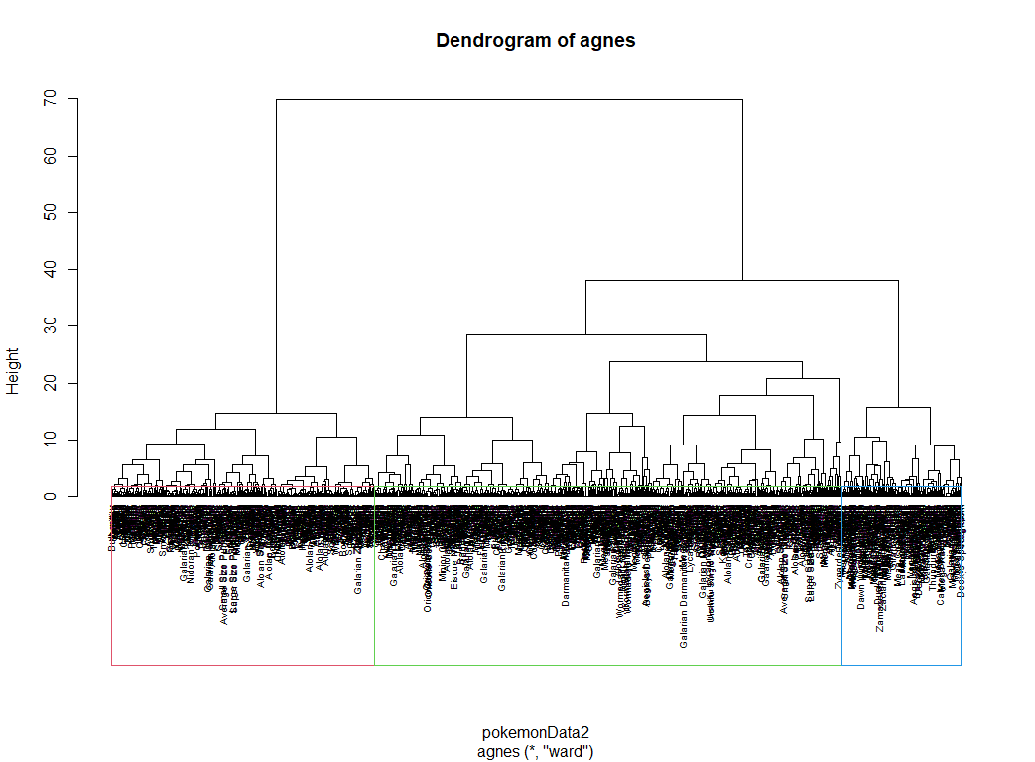
Decision Tree:
Too many different species made the whole decision tree is hard to find detailed information. However, we can find the k number for our clustering.

Slide 10
Model comparison - CV 3 fold
SVM Linear Kernel
Cross-Validated (3 fold) Confusion Matrix
(entries are percentual average cell counts across resamples)
Reference
Prediction 0 1
0 84.5 3.2
1 3.5 8.9
Accuracy (average) : 0.9335
SVM Radial Kernel
Cross-Validated (3 fold) Confusion Matrix
(entries are percentual average cell counts across resamples)
Reference
Prediction 0 1
0 85.3 4.6
1 2.6 7.5
Accuracy (average) : 0.928
SVM Polynomial Kernel
Cross-Validated (3 fold) Confusion Matrix
(entries are percentual average cell counts across resamples)
Reference
Prediction 0 1
0 85.5 4.3
1 2.5 7.8
Accuracy (average) : 0.9321
KNN
Cross-Validated (3 fold) Confusion Matrix
(entries are percentual average cell counts across resamples)
Reference
Prediction 0 1
0 85.5 2.4
1 2.5 9.7
Accuracy (average) : 0.9515
Random Forest (Highest Accuracy)
Cross-Validated (3 fold) Confusion Matrix
(entries are percentual average cell counts across resamples)
Reference
Prediction 0 1
0 84.9 1.9
1 2.8 10.4
Accuracy (average) : 0.9529

Slide 11
Model comparison - CV 5 fold, repeated 10 times
SVM Linear Kernel
Cross-Validated (5 fold, repeated 10 times) Confusion Matrix
(entries are percentual average cell counts across resamples)
Reference
Prediction 0 1
0 84.9 4.6
1 3.1 7.4
Accuracy (average) : 0.923
SVM Radial Kernel
Cross-Validated (5 fold, repeated 10 times) Confusion Matrix
(entries are percentual average cell counts across resamples)
Reference
Prediction 0 1
0 85.1 4.4
1 2.9 7.7
Accuracy (average) : 0.9271
SVM Polynomial Kernel
Cross-Validated (5 fold, repeated 10 times) Confusion Matrix
(entries are percentual average cell counts across resamples)
Reference
Prediction 0 1
0 84.9 3.9
1 3.0 8.2
Accuracy (average) : 0.9309
Knn
Cross-Validated (5 fold, repeated 10 times) Confusion Matrix
(entries are percentual average cell counts across resamples)
Reference
Prediction 0 1
0 85.4 2.8
1 2.5 9.2
Accuracy (average) : 0.9463
Random Forest (Highest Accuracy)
Cross-Validated (5 fold, repeated 10 times) Confusion Matrix
(entries are percentual average cell counts across resamples)
Reference
Prediction 0 1
0 85.8 1.8
1 2.1 10.3
Accuracy (average) : 0.9611

Slide 12
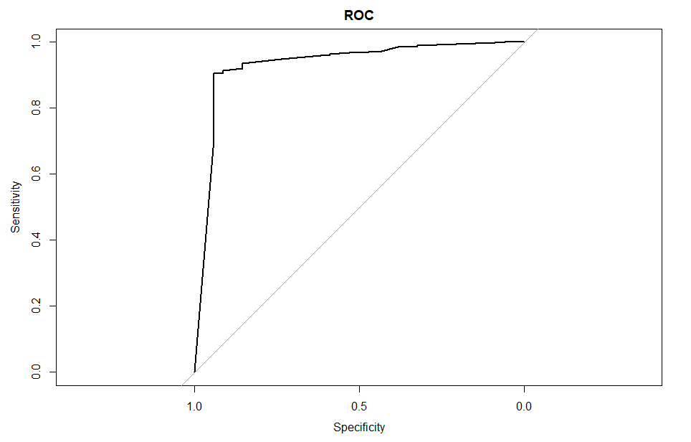
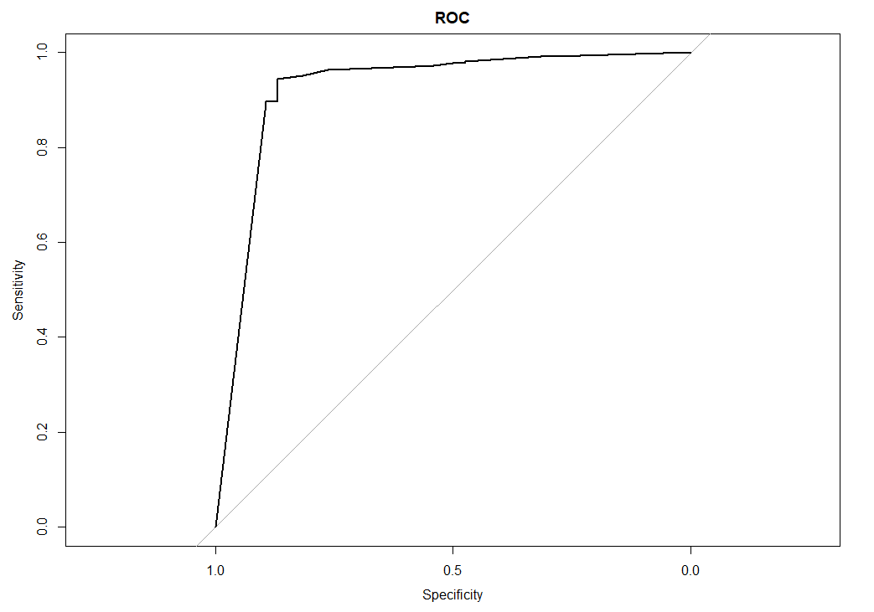
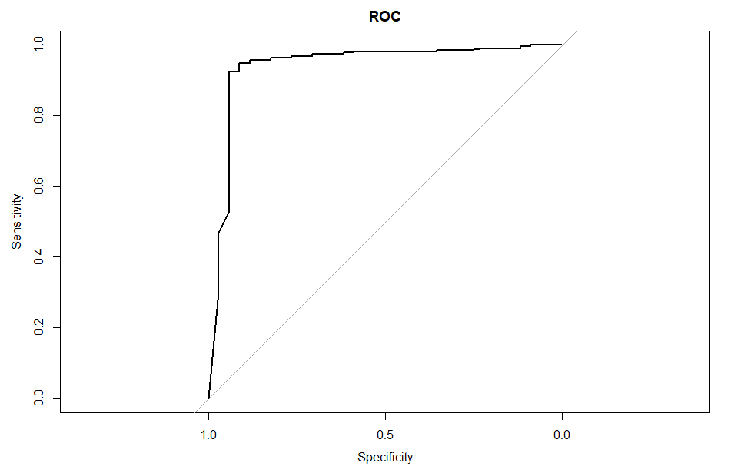
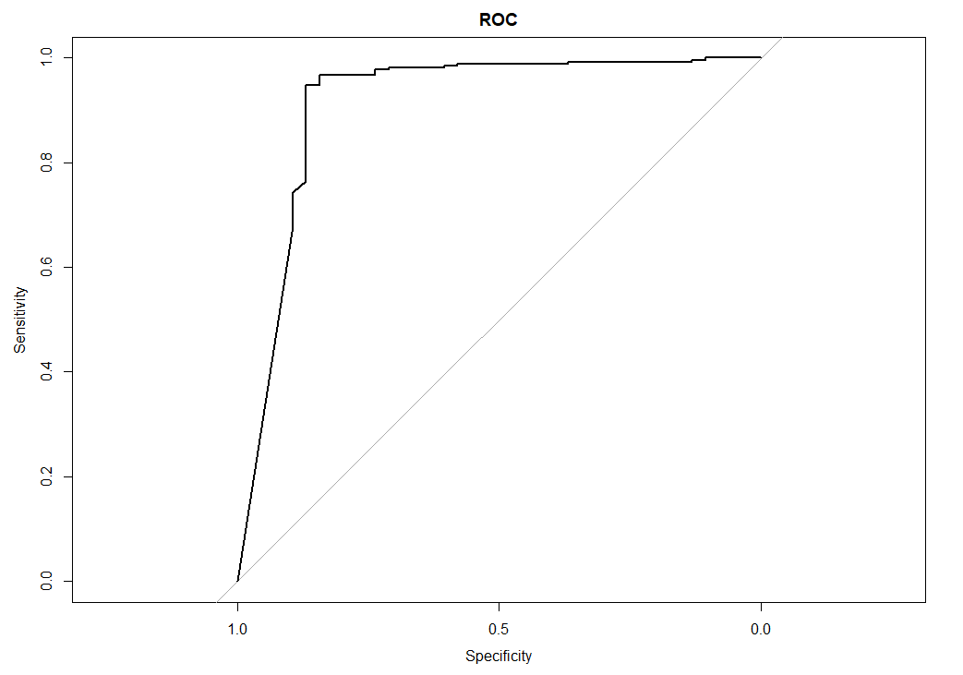
ROC:
SVM linear 3 fold
Knn 3 fold
Random Forest 5 fold repeated 10 times
Random Forest 3 fold

Slide 13

Unsupervised Learning:
Clustering Algorithms

Slide 14
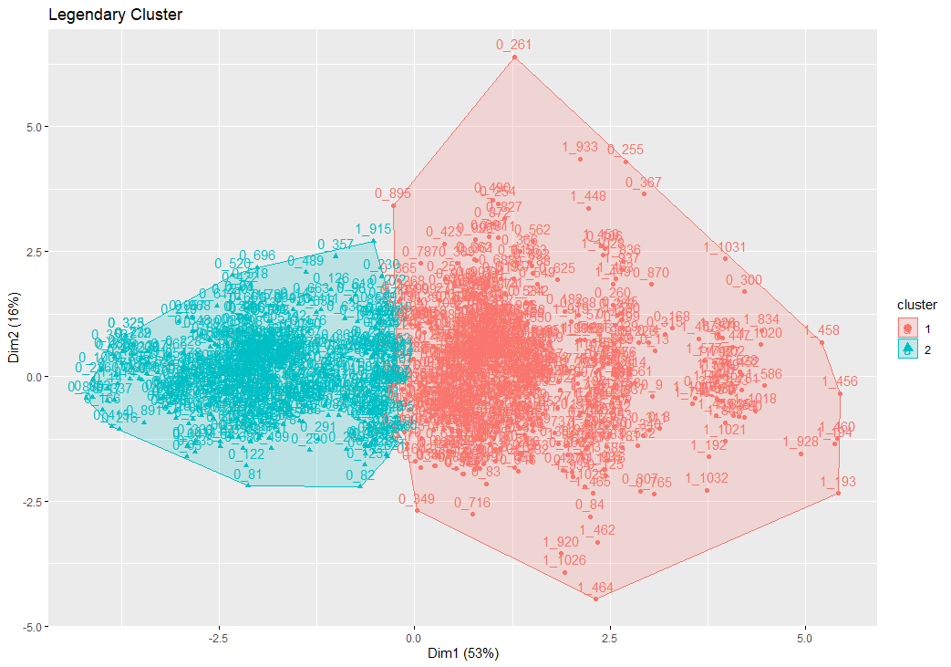
Clustering Algorithm:
0_iii: Non-Legendary
1_iii: Legendary
Legendary
Non-Legendary

Slide 15
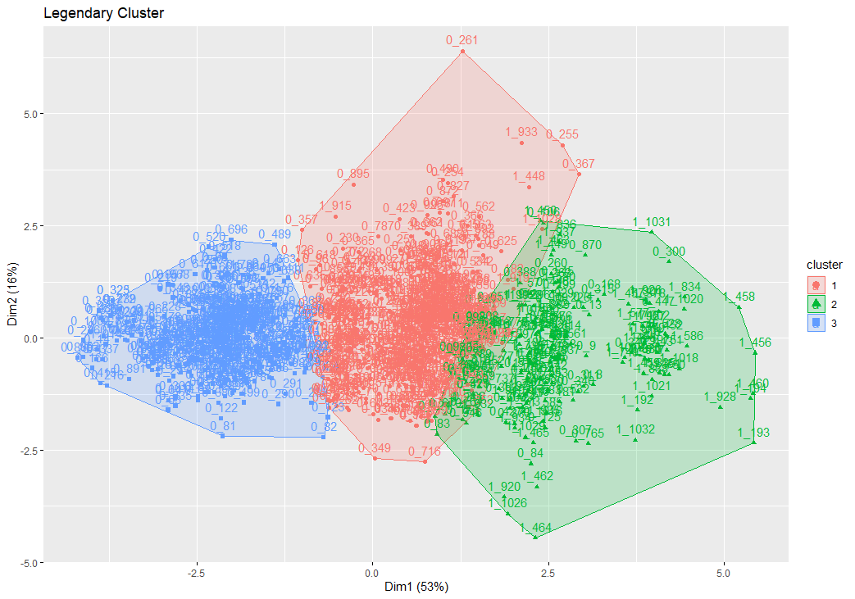
Clustering Algorithm:
Only a few Legendaries
0_iii: Non-Legendary
1_iii: Legendary
Many Legendaries
Non-Legendary

Slide 16

Questions?
Source From: https://www.kaggle.com/akbarjaffery/pokmon-pokedex-gens-18

